Slide 1
Frequency Distribution of GOES Solar Flare Peak Fluxes from 1994 to 2005
Nicholas Shields
SESI Presentation – CUA Student
Brian Dennis (Mentor)

Slide 2
OVERVIEW
Background on GOES satellites
GOES Event list
Size Distribution
Fit power-law to the size distribution
Notes:
To see if there is a change in the slope of the size distribution over time.

Slide 3
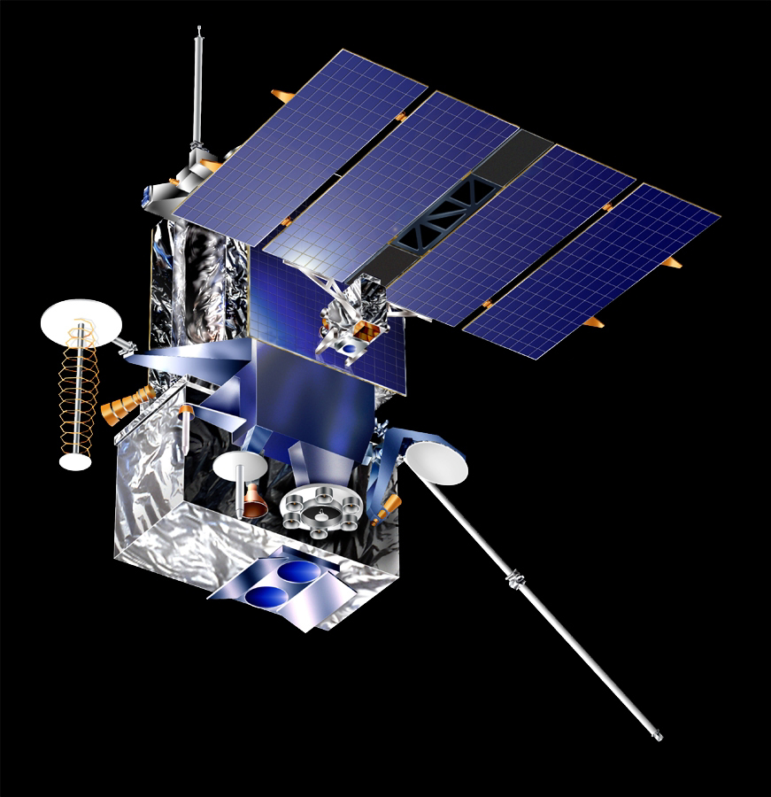
What is GOES?
Geostationary Operational Environmental Satellites
X-ray Spectrometer
3 second data in two wavelengths
1-8 Angstrom
0.5-4 Angstrom
Notes:
A series of satellites know as the Geostationary Operational Environmental Satellites
Operated continuously since 1975. We will only examine data from 1980 to 2010.
Every three seconds these satellites recorded X-ray data in two wavelength bands, recording flux level fluctuation.
Drawback of RHESSI is that it only operates during the day. GOES operates all the time.

Slide 4
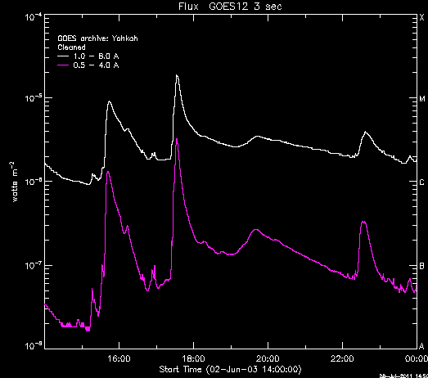
GOES Spectra Data:

Slide 5
Event Detection
First we take the raw data and smooth it using either a boxcar smoothing or an average smoothing
The derivative of the data is taken
Where the derivative crosses zero we find either a peak or a valley
Notes:
1. Boxcar smoothing moves point by point and averages using points on either side so it averages over already smoothed data, average smoothing takes a set number of points (say 10 points) and averages those points and then moves to the next 10. Average smoothing is the preferred because it makes the points independent of the next.

Slide 6
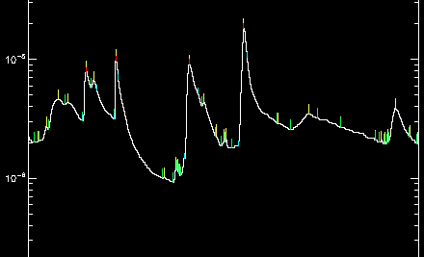
Example of Event Detection:

Slide 7
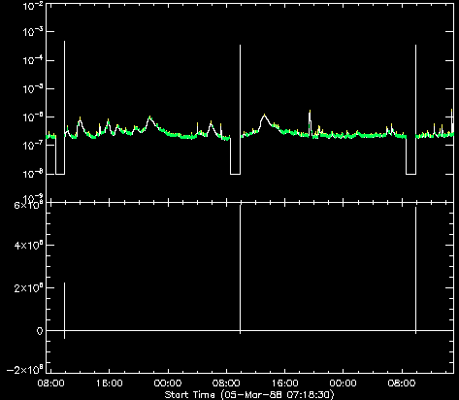
Data-drop/spike Filter:
The SDAC data often has drops or spikes that we do not want to declare peaks and valleys.
Notes:
This filter goes two ways depending on the smoothing method.
If boxcar smoothing is being used then if either interval is less than the nsmooth variable * 3 then the peak is removed. With the standard settings this requires the intervals to be greater than 15 seconds.
If average smoothing is used then if either interval is less than the number of points averaged then the peak is removed. This is usually 30 seconds.

Slide 8
Time Filter
The time intervals between a valley the next peak and the following valley are examined:
Notes:
This filter goes two ways depending on the smoothing method.
If boxcar smoothing is being used then if either interval is less than the nsmooth variable * 3 then the peak is removed. With the standard settings this requires the intervals to be greater than 15 seconds.
If average smoothing is used then if either interval is less than the number of points averaged then the peak is removed. This is usually 30 seconds.

Slide 9
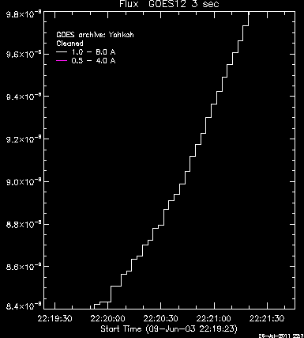
Quantization Filter
Quantization level = flux value where the step size changes
Matches peak flux to quantization level
Difference between peak and valley flux values must be greater than quantization step * 3
Notes:
The quantization step level changes depending on the satellite and flux level.
We found a satellite to have as many as 8 different step sizes.

Slide 10
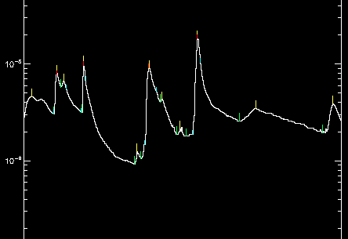
Effects of the Time & Quantization Filter:

Slide 11
Background Subtraction: Method
GOES satellite records even non-flaring plasma
Difficult to distinguish the flux levels of the smaller solar flares
Linear background subtraction
Runs from one valley to the next
It takes the flux level at the first valley and subtracts it from every point in the data array until reaching the next valley

Slide 12
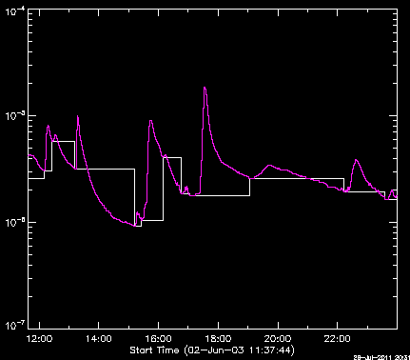
Example of Background Subtraction:

Slide 13
Size Distribution
A size distribution was performed on
un-subtracted data
background subtracted data.
Binned the data by the flare size
Shows the frequency of solar flares over time based on their size
Notes:
A size distribution was performed on both the un-subtracted filtered data and the background subtracted filtered data.
This was done by creating a histogram in which the flux levels were graphed versus the number of flares divided by the bin width.

Slide 14
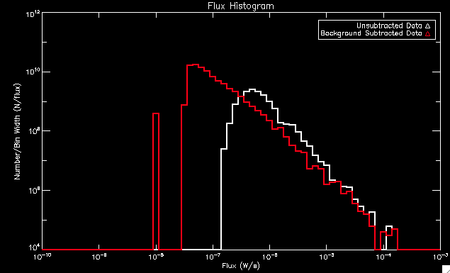
Example of Size Distribution:

Slide 15
Power-Law Fits
Used OSPEX (object spectral executive)
Automatic fit using the closest parameter settings
Single power law fit
dN(p)/dp = A p^{−α}
dN(p) is the number of events with a “size” between p and p + dp
A is a normalization parameter
and α is the power-law index

Slide 16
Power-Law Fits Example

Slide 17
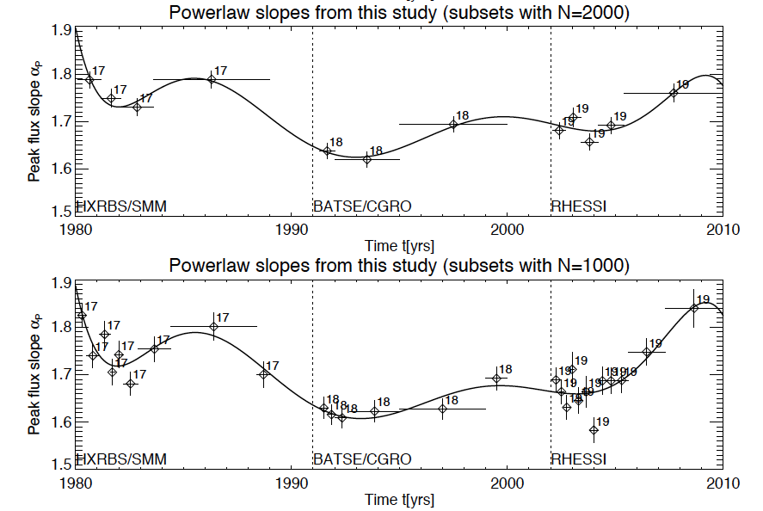
Past Results

Slide 18
1994 to 2005 Results

Slide 19
Work Still to be Done:
Change to creating a size distribution for a set number of flares rather than a set time interval
Use c-statistic to find the fit parameters rather than chi-squared

Slide 20
Acknowledgements
Brian Dennis
Andy Gopie
Richard Schwartz
Kim Tolbert
Fred Bruhweiler

